Slide 1
ThiefGuard: Real-time Theft Detection System Integrating YOLO and GeminI for Enhanced Accuracy and Rapid Response
Project Guide Project Coordinator
Mr D.Ranjith Mrs.J.Bhargavi
Assistant Professor Assistant Professor
Team Members
Muskaan Thabassum(21AG1A66A3)
Dhanush Kanraj(21AG1A6690)
B.Bharath Kumar(21AG1A6675)
.

Slide 2
List OF CONTENTS
Abstract
Introduction
Literature Survey
Requirements
Architecture
UML Diagrams
Implementation
Testing
Future Enhancements
Conclusion

Slide 3
ABSTRACT
ThiefGuard is a real-time theft detection system designed to enhance the accuracy and reliability of surveillance systems. By utilizing the YOLO model for high-speed object detection and GeminI for secondary verification, the system minimizes false positives and ensures robust performance. The application supports both image and video inputs, making it adaptable to diverse surveillance scenarios. Integrated with an automated alert system, ThiefGuard sends email notifications with location details, enabling rapid response to theft incidents. Deployed as a Streamlit-based platform, it offers a scalable and user-friendly interface, combining advanced deep learning techniques to provide a cutting-edge solution for theft prevention.

Slide 4
INTRODUCTION
The Thief Guard Project is an intelligent theft detection system designed to enhance security using advanced technologies. It integrates YOLOv8 for real-time object detection, Streamlit for an interactive interface, and Generative AI for smart decision-making. The system includes features like user authentication, a live dashboard, alert notifications, and location tracking, making it an efficient and user-friendly solution for monitoring and preventing theft.

Slide 5
Existing system
Traditional surveillance systems rely on manual monitoring of security footage, which is time-consuming and prone to human error.
Automated systems often lack precision and adaptability to varying conditions, leading to high false positives and missed detections.
Current AI models used in theft detection struggle with real-time performance and cannot effectively verify detections, reducing reliability.

Slide 6
Disadvantages of Existing System
Relies heavily on human monitoring, leading to oversight and inefficiencies.
Automated systems lack adaptability to varying conditions, such as poor lighting.
High rates of false positives create unnecessary interventions and alarm fatigue.
Absence of real-time notifications delays immediate action during theft incidents.
Most systems fail to integrate with modern alert and reporting mechanisms.

Slide 7
Proposed System
Implementation of the YOLO model for real-time theft detection, ensuring high-speed object recognition and initial classification.
Integration of GeminI for secondary verification, reducing false positives and improving detection reliability.
Supports both image and video inputs, making the system versatile for various surveillance scenarios.
Deployment of the system as a Streamlit-based application for seamless user interaction and accessibility.

Slide 8
Advantages of Proposed System
High Accuracy with Dual-Layer Verification:
Integrating YOLO for initial detection and GeminI for secondary verification reduces false positives and enhances reliability.
Versatile Input Support:
The system processes both image and video inputs, adapting to diverse surveillance setups and use cases.
User-Friendly Interface:
A Streamlit-based interface simplifies user interaction, making the system accessible and easy to deploy.

Slide 9
Literature Survey
S.No. | Author(s) & Year | Title | Methodology | Relevance to ThiefGuard
1 | Chandrasekaran, K. P. (2023) | YOLO ROBBERY: Video Surveillance Based Robbery Prediction and Alert System | Utilizes YOLO V7 for real-time robbery prediction and alert generation. | Directly aligns with real-time theft detection and YOLO-based implementation.
2 | Khadse, S., et al. (2022) | Machine Learning Based Theft Detection Using YOLO Object Detection | Employs YOLO for theft detection, focusing on video inputs for security. | Provides foundational insights into YOLO’s application for theft detection.
3 | Malekar, M. (2021) | Detecting Criminal Activities in Surveillance Videos Using Deep Learning | Uses deep learning models to detect suspicious activities in videos. | Offers techniques for identifying criminal behavior, relevant for enhancing verification.
4 | Sakiba, C., et al. (2023) | Real-Time Crime Detection Using Convolutional LSTM and YOLOv7 | Integrates YOLOv7 and LSTM for dynamic, real-time crime detection. | Relevant for combining YOLO with advanced techniques to handle complex real-time scenarios.

Slide 10
.
S.No. | Author(s) & Year | Title | Methodology | Relevance to ThiefGuard
5 | Kakadiya, R., et al. (2019) | AI-Based Automatic Robbery/Theft Detection Using Smart Surveillance in Banks | Implements AI-powered theft detection with smart surveillance for banks. | Highlights the use of AI in theft prevention and applications for sensitive environments.
6 | Vidanage, K. H., et al. (2023) | Human, Object, and Pose Detection for Theft Prevention Through Surveillance | Combines object and pose detection for theft prevention in real-time systems. | Relevant for pose-based secondary verification and theft prevention.
7 | Shafi, S., et al. (2023) | Deep Learning Based Real-Time Stolen Vehicle Detection Model | Uses deep learning to detect stolen vehicles with improved precision. | Offers insights into precision optimization and real-time detection methods.
8 | Ansari, M. A., & Singh, D. K. (2022) | An Expert Video Surveillance System to Identify and Mitigate Shoplifting | Utilizes video surveillance and deep learning to identify shoplifting behavior. | Provides ideas for reducing false positives in theft detection.

Slide 11
REQUIREMENTS
Hardware Requirements
Microsoft Server-Enabled Computers
RAM: Minimum of 4GB or above
Software Requirements
Python 3.9 or Higher
Visual Studio Code
Processor: Minimum frequency of 1.5GHz or above

Slide 12
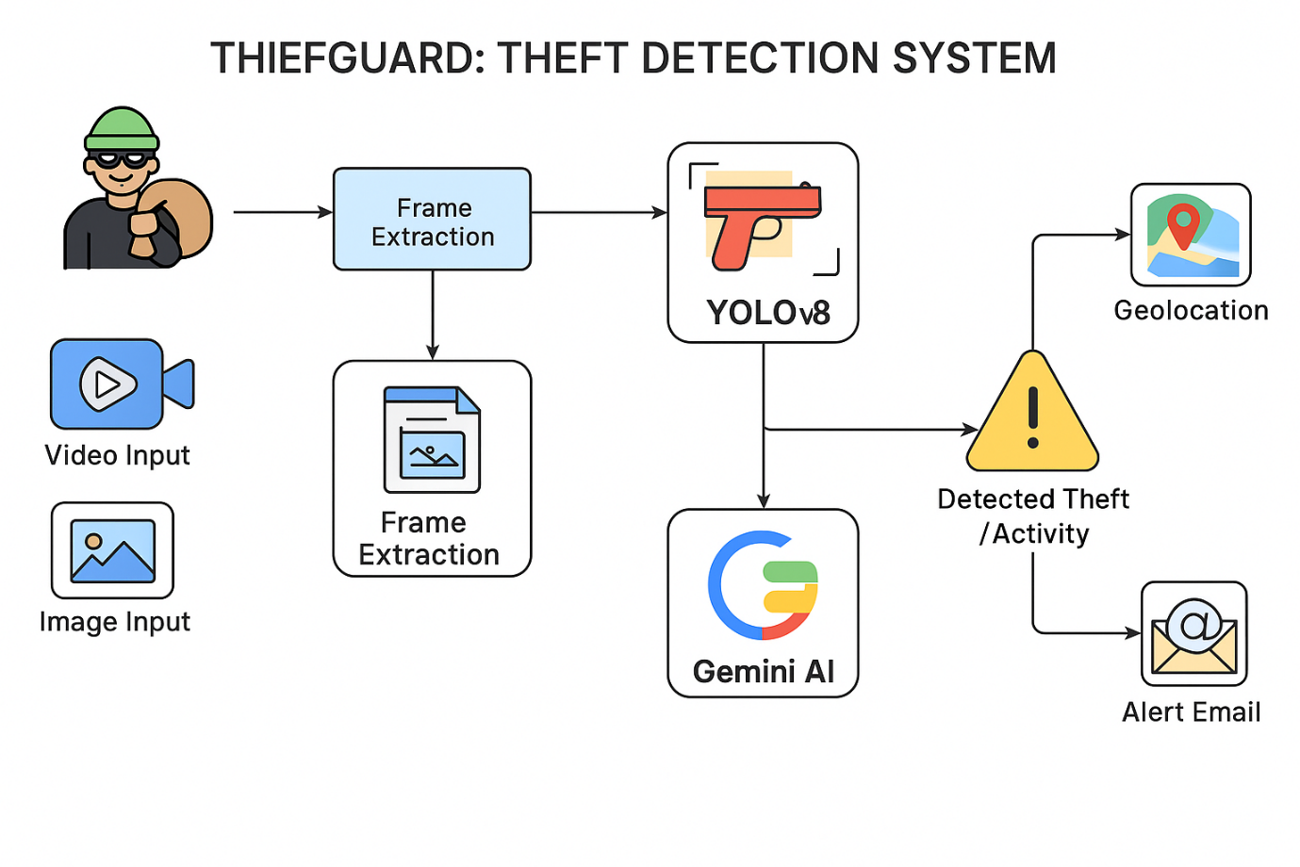
SYSTEM ARCHITECTURE

Slide 13
SYSTEM MODULE
Input Module
Object Detection Module(YOLO)
Verification Module (GeminI)
Alert and Notification Module
User Interface Module (Streamlit Application)

Slide 14
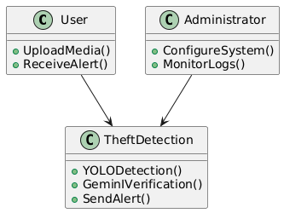
CLASS DIAGRAM
UML DIAGRAMS

Slide 15
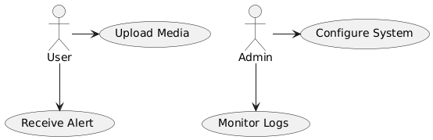
USE CASE DIAGRAM

Slide 16
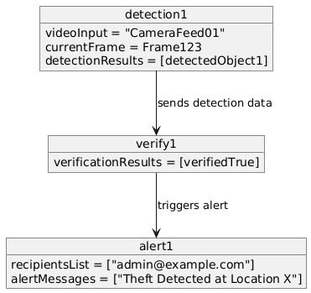
OBJECT DIAGRAM

Slide 17
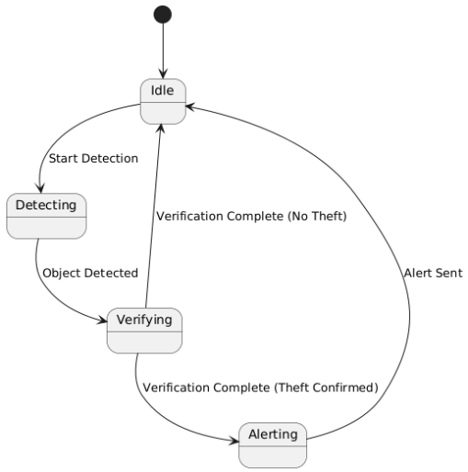
STATE CHART DIAGRAM

Slide 18
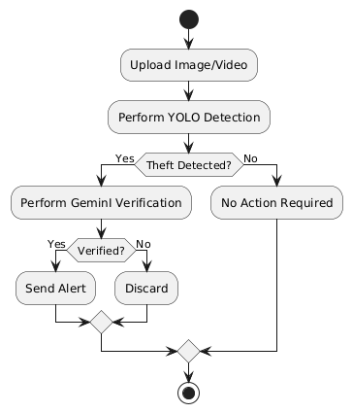
ACTIVITY DIAGRAM

Slide 19
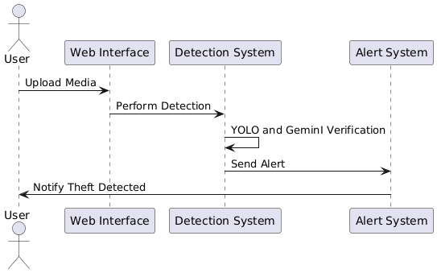
SEQUENCE DIAGRAM

Slide 20
COLLABORATION DIAGRAM

Slide 21
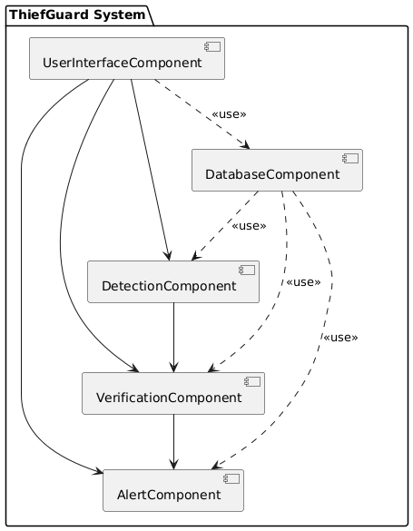
COMPONENT DIAGRAM

Slide 22
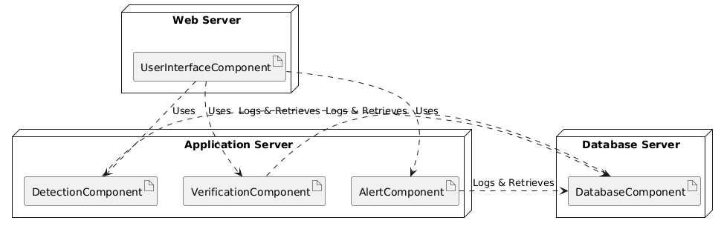
DEPLOYMENT DIAGRAM

Slide 23
ALGORITHM
Step 1: Pass YOLO Outputs to the GeminI Model
Transfer the flagged outputs from YOLO to the secondary verification model, GeminI.
Prepare the detected data for in-depth analysis.
Step 2: Perform Secondary Analysis
Analyze the input data using GeminI’s advanced verification mechanisms.
Validate the detections by comparing patterns, motion, and behavior.
Step 3: Reject False Positives
Discard incorrect detections to improve system reliability.
Focus on confirming only valid theft instances.
Step 4: Confirm Valid Theft Activities
Identify verified theft events with high accuracy using the dual-layer system.
Maintain a log of confirmed events for future audits.
Step 5: Trigger Alert Mechanisms
Notify users immediately via email alerts with detailed theft information.
Log the event in the system database and update the user interface.

Slide 24
.
IMPLEMENTATION
The system relies on various libraries and tools to achieve its functionality. Each library plays a specific role in the development and deployment of ThiefGuard:
Deep Learning Frameworks:
  TensorFlow and PyTorch:
    TensorFlow and PyTorch are used to implement and fine-tune the YOLO and GeminI models.
    They provide the flexibility to handle large datasets, optimize model performance, and manage GPU acceleration for faster training and inference.
Image and Video Processing:
  OpenCV:
    OpenCV is used for image and video preprocessing, such as resizing, cropping, and frame extraction from video inputs.
    It also handles visualization tasks, such as drawing bounding boxes around detected objects.
Data Preprocessing:
  scikit-learn:
    Used for preprocessing data, including normalization, splitting datasets, and scaling inputs.
    Also assists in evaluating model performance through metrics like accuracy, precision, and recall.

Slide 25
.
Web-based Deployment:
  Streamlit:
    Streamlit provides an intuitive and interactive web-based interface for users to interact with the system.
    It enables live feed monitoring, media uploads, and customization of detection settings.
Object Detection Models:
  YOLO (You Only Look Once):
    YOLO is the primary object detection model used for real-time identification of theft activities.
  GeminI:
    Acts as a secondary layer for verifying YOLO’s outputs, reducing false positives and enhancing reliability.

Slide 26
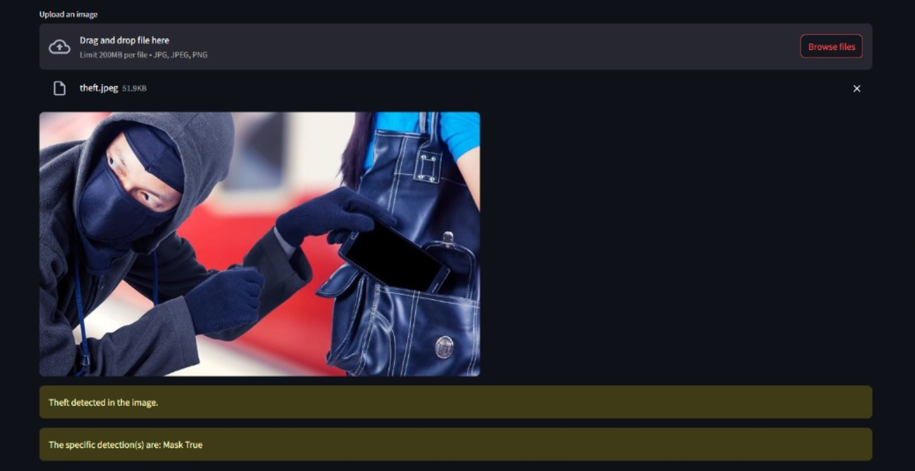
OUTPUT

Slide 27
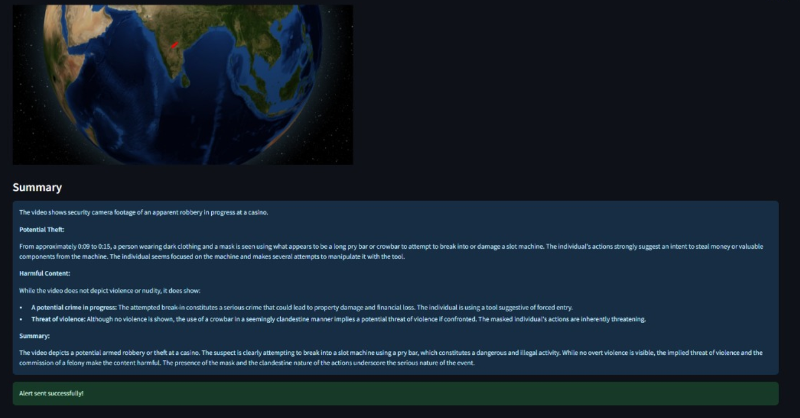
OUTPUT

Slide 28
TESTING
Software testing is the process of evaluating a software application to identify any errors, gaps, or missing requirements compared to the expected outcomes.
The primary objective of the testing process is to ensure the accuracy, reliability, and robustness of the ThiefGuard system.

Slide 29
TEST CASES
Test ID | Test Description | Test Design | Expected Output | Actual Output | Status
1 | Verify user signup with OTP email verification. | Enter signup details, system sends OTP to email, user enters OTP. | User signed up successfully after valid OTP. | User account created after OTP verification. | Pass
2 | Validate login functionality. | Enter valid/invalid login credentials. | Valid credentials allow access; invalid shows error. | Login worked correctly with valid input; error shown for invalid. | Pass
3 | Check if user details saved to dashboard post signup. | Complete signup and view dashboard. | User's name and info appear on dashboard. | Dashboard updated with correct user details. | Pass
4 | Test thief detection using image input. | Upload an image containing a suspicious person. | Thief detected if match found. | Thief detected in the image. | Pass
5 | Test thief detection using video input. | Upload a video clip with theft scenario. | Thief detected in frame. | Theif detected in the video. | Pass
6 | Test thief detection via live camera feed. | Use webcam or CCTV input to monitor real-time activity. | System detects thief in live feed. | Theif detected in the camera. | Pass
7 | Validate location tracking after thief detection. | Trigger thief detection and track via globe. | Location is pinpointed with red line on 3D globe. | Accurate location marked on globe. | Pass
8 | Check alert email sent when thief is detected. | Simulate theft and monitor email. | Email alert with location sent to email. | Alert send successfully. | Pass

Slide 30
FUTURE ENHANCEMENTS
Mobile App Deployment
Night Vision and Low-light Enhancement
Real-time Integration with Police or Emergency Services
Multilingual Voice Alerts

Slide 31
CONCLUSION
ThiefGuard provides a robust and efficient solution for real-time theft detection by integrating advanced deep learning models like YOLO and GeminI.
The system addresses the limitations of traditional surveillance methods by offering high accuracy, reduced false positives, and real-time alerts.
Its support for both image and video inputs ensures versatility, while the Streamlit-based application enhances accessibility and user interaction.
By leveraging cutting-edge technologies and a scalable architecture, ThiefGuard sets a benchmark for modern theft prevention systems, ensuring timely and reliable security interventions.

Slide 32
THANK YOU

